Slide 1
COS30008 Data Structures and Patterns Lecture 4 - Basic Concepts

Slide 2
Programming Paradigms
Imperative style:
program = algorithms + data
Functional style:
program = function ⦁ function
Logic programming style:
program = facts + rules
Object-oriented style:
program = objects + messages

Slide 3
Values
In computer science we classify as a value everything that maybe evaluated, stored, incorporated in a data structure, passed as an argument to a procedure or function, returned as a function result, and so on.
In computer science, as in mathematics, an “expression” is used (solely) to denote a value.
Which kinds of values are supported by a specific programming environment depends heavily on the underlying paradigm and its application domain.
Most programming environments provide support for some basic sets of values like truth values, integers, real number, records, lists, etc.

Slide 4
Constants
Constants are named abstractions of values.
Constants are used to assign an user-defined meaning to a value.
Examples:
EOF = -1
TRUE = 1
FALSE = 0
PI = 3.1415927
MESSAGE = ”Welcome to DSP”

Slide 5
Primitive Values
Primitive values are values whose representation cannot be further decomposed. We find that some of these values are implementation and platform dependent.
Examples:
Truth values,
Integers,
Characters,
Strings,
Enumerands,
Real numbers

Slide 6
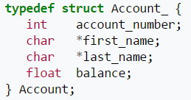
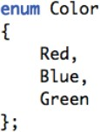
Composite Data Type
Composite types are built up using primitive values and composite types. The layout of composite types is in general implementation dependent.
E.g.
struct,
array
enumerations
files
etc
https://en.wikipedia.org/wiki/Composite_data_type

Slide 7
Pointers
Pointers are references to values, i.e., they denote locations of a values.
Pointers are used to store the address of a value (variable or function) – pointer to a value, and pointers are also used to store the address of another pointer – pointer to pointer.
In general, it not necessary to define pointers with a greater reference level than pointer to pointer.
In modern programming environments, we find pointers to variables, pointers to pointer, function pointers, and object pointers, but not all programming languages provide means to use pointers directly (e.g., Java).
http://stackoverflow.com/questions/8080617/does-java-really-have-pointers-or-not

Slide 8
Arrays
An array is a compound data type that consists of
a type specifier,
an identifier, and
a dimension.
Arrays define an ordered, homogeneous sequence of data of a specific length.
Arrays define a number-based position association among the elements.
The compiler can reserve the required amount of space when the program is compiled.

Slide 9
C++ Array Examples
const unsigned int buf_size = 512, max_files = 20; int staff_size = 27;
const unsigned int sz = get_size();
// const value not known until runtime
char input_buffer[buf_size];
string fileTable[max_files + 1];
int chess_board[8][8]; // two-dimensional array
double salaries[staff_size]; // error: non const variable int test_scores[get_size()]; // error: non const expression int vals[sz]; // error: sz not known until runtime

Slide 10
Explicitly Initialized Arrays
int arr1[20] = { 1 };
Array of 20 integers with arr1[0] == 1 and arr1[i] == 0 for 1 < i < 20.
int arr2[] = { 1, 2, 3, 4, 5 };
Array of 5 integers initialized 1, 2, 3, 4, and 5.
int arr3[10];
Array of 10 integers, none initialized.
Data members of array type are
Not initialized if the base type is a built-in data type
Initialized (using the default constructor) if the base type is a class type.

Slide 11
Multi-Dimensional Array Initialization
int board[3][3] = { {1, 2, 3} };
only the first row is initialized, the remaining elements are set to integer 0
char tic-tac-toe[][3] = { {‘_’, ‘_’, ‘_’},
{‘_’, ‘_’, ‘_’},
{‘_’, ‘_’, ‘_’} };
fully-initialized array of 3×3 characters (‘_’)

Slide 12
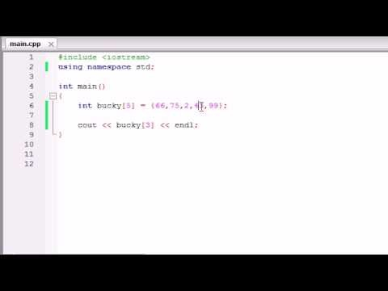
Arrays in C++
URL: https://www.youtube.com/watch?v=1kLw8kZuccQ

Slide 13
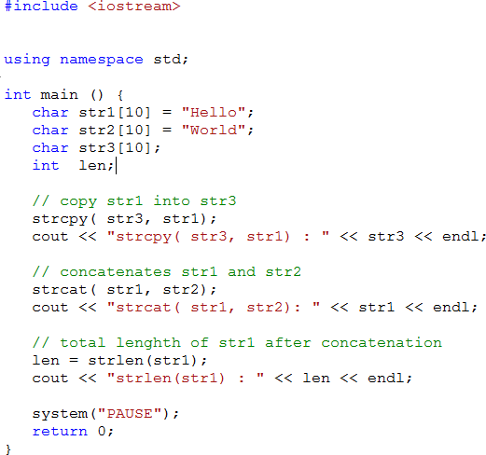
String handling in C++
For C++, there are two ways to handle string.
using string.h
using c style string
Can this program be compiled correctly and run correctly?

Slide 14
C-Strings
A C-String is an array of characters: i.e. C-style string
char a_string[] = “Hello World!”;
The length of a C-String is the number of characters of the C-String plus one:
char a_string[] = { ‘H’, ‘e’, ‘l’, ‘l’, ‘o’, ‘ ’, ‘W’, ‘o’, ‘r’, ‘l’, ‘d’, ‘!’, ‘\0’ };
advantage: array element accessing using array index
disadvantage: specify the size needed in advance
static allocation: the size of the array is determined at compile-time

Slide 15
A C-String Array
#define MAX_ID_LENGTH 5
char keywords[][MAX_ID_LENGTH] =
{
"if",
"then", "else"
The first dimension of an array can be unspecified!
};

Slide 16
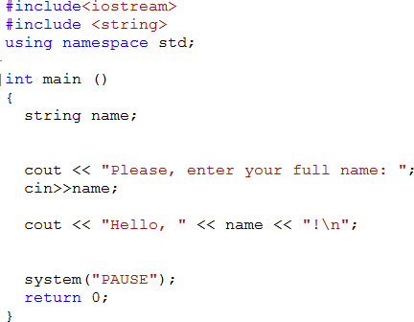
String
Another way, maybe a better way is using character pointer to keep track of a string.
Can this program be compiled correctly and run correctly?

Slide 17
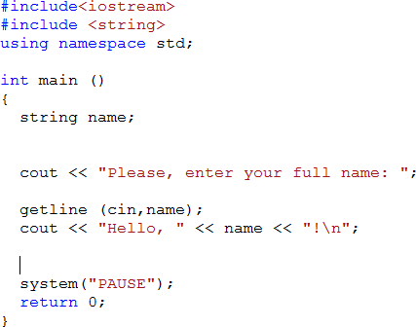
String
Using getline, we can get the whole name including spaces

Slide 18
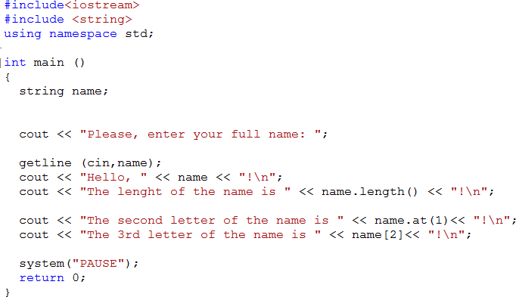
String

Slide 19
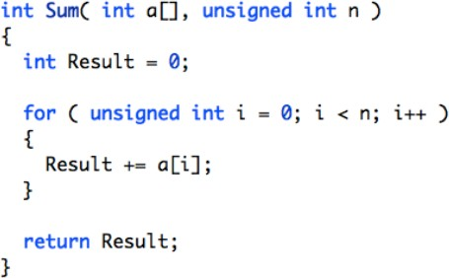
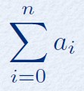
Sum
The sum of all elements of an array

Slide 20
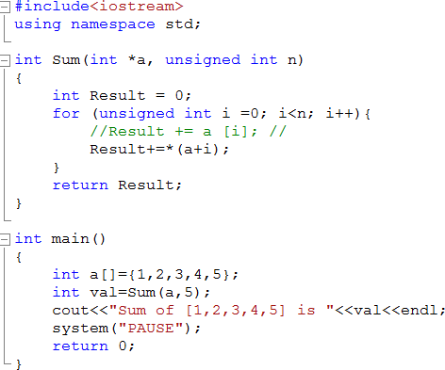
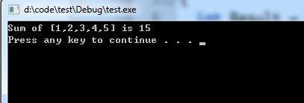
Testing sum
This is not a good practice and only available for MSVC

Slide 21
Associative Array
An associate array is a map in which elements are indexed by a key rather than by an integer index number.
Example:
a = { {“u”, 345}, {“v”, 2}, {“w”, 39}, {“x”, 5} }
a[“w”] = 39

Slide 22
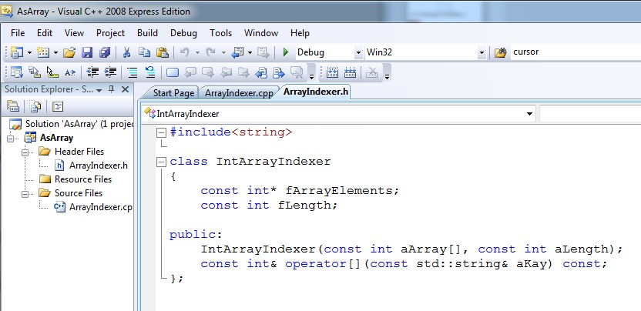
From Indices to Keys
We can define an adapter class that defines an indexer:

Slide 23
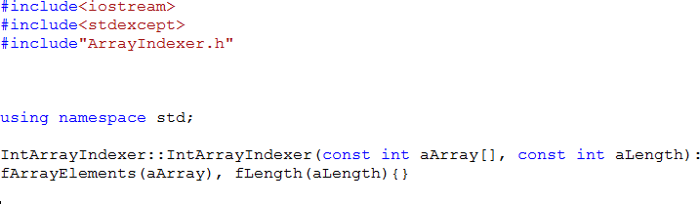
From Indices to Keys
Arrays are passed as pointers to the first element to functions in C++.
We must use member initializer to initialize const instance variables!

Slide 24
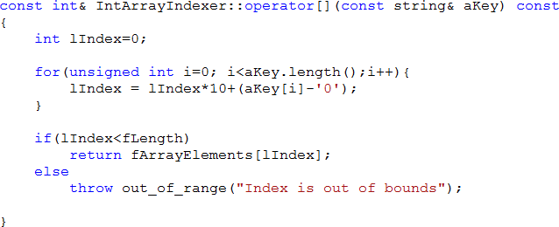
The indexer - the operator[]
We use the const specifier to indicate that the operator[]:
is a read-only getter
does not alter the elements of the underlying collection
We use a const reference to avoid copying the original value stored in the underlying collection.

Slide 25
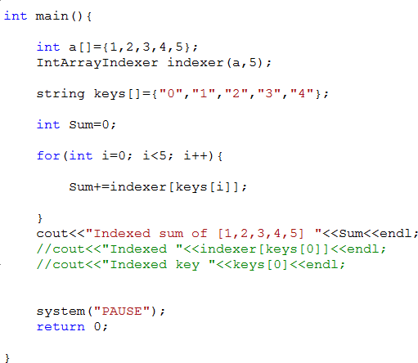
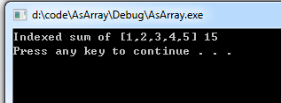
Testing the Indexer

Slide 26
Iterators
Iterator: a pointer-like object that can be incremented with ++, dereferenced with *, and compared against another iterator with !=.
Iterators are generated by STL container member functions, such as begin() and end(). Some containers return iterators that support only the above operations, while others return iterators that can move forward and backward, be compared with <, and so on.
Dereferencing a pointer means getting the value that is stored in the memory location pointed by the pointer.

Slide 27
Iterators
The generic algorithms use iterators just as you use pointers in C to get elements from and store elements to various containers. Passing and returning iterators makes the algorithms
more generic, because the algorithms will work for any containers, including ones you invent, as long as you define iterators for them
more efficient (as discussed here)
Some algorithms can work with the minimal iterators, others may require the extra features. So a certain algorithm may require certain containers because only those containers can return the necessary kind of iterators.

Slide 28
types of Iterators
Input Iterator
Output Iterator
Forward Iterator
Bidirectional Iterator
Random Access Iterator

Slide 29
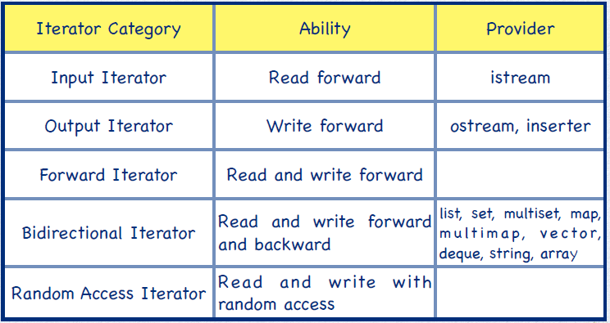
Abilities of Iterators
template
containers

Slide 30
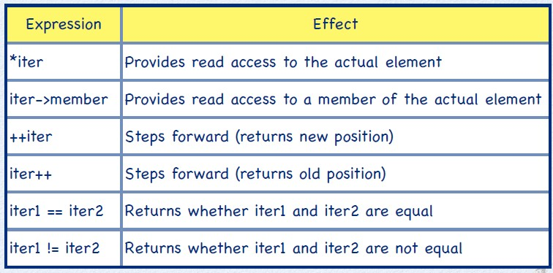
Input Iterator

Slide 31
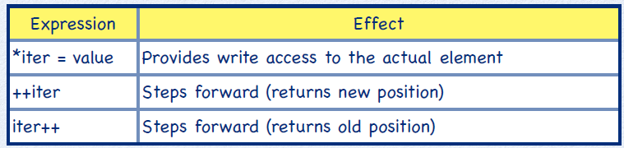
Output Iterator

Slide 32
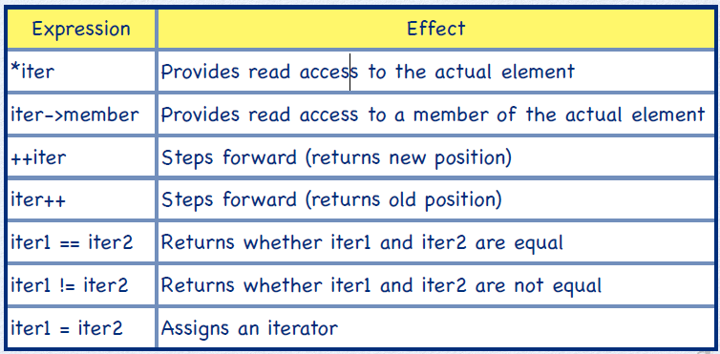
Forward Iterator

Slide 33
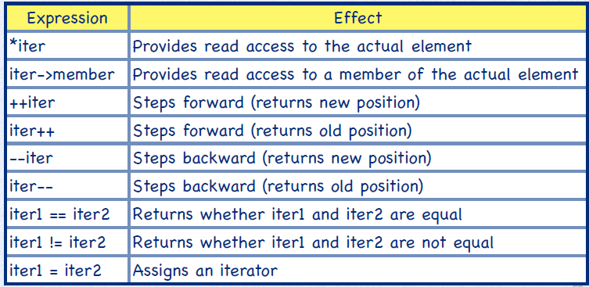
Bidirectional Iterator

Slide 34
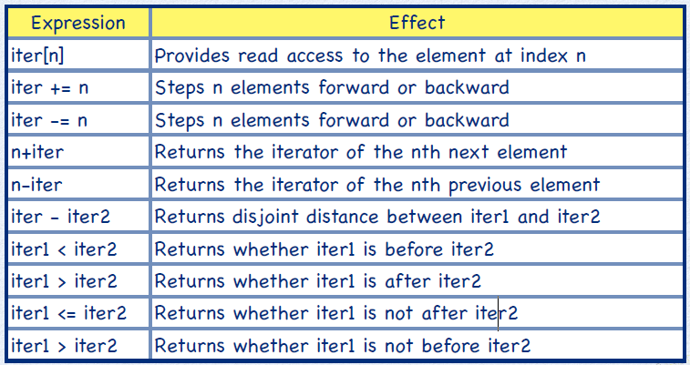
Random Access Iterator

Slide 35
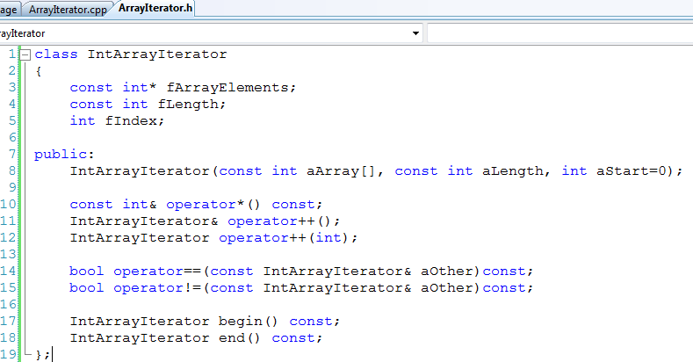
A Read-Only Forward Iterator

Slide 36
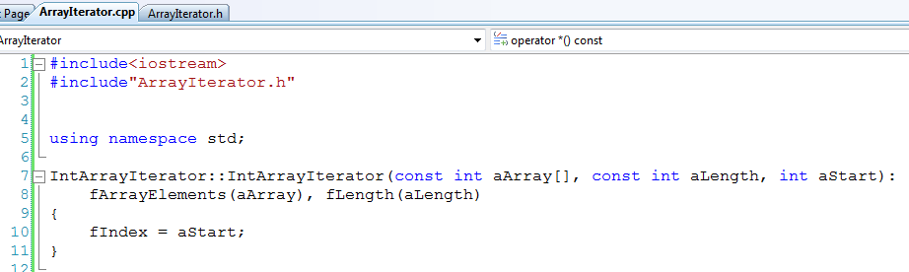
Forward Iterator Constructor
Arrays are passed as pointers to the first element to functions in C++.
use member initializer to initialize const instance variables!
Not repeating the default value

Slide 37

The Dereference Operator
The deference operator returns the element the iterator is currently positioned on.
The dereference operator is a const operation, that is, it does not change any instance variables of the iterator.
We use a const reference to avoid copying the original value stored in the underlying collection.

Slide 38
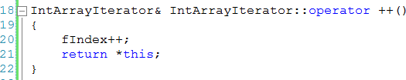
Prefix Increment
The prefix increment operator advances the iterator and returns a reference of this iterator.

Slide 39
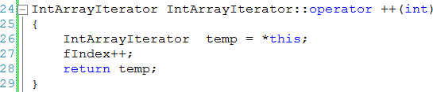
Postfix Increment
The postfix increment operator advances the iterator and returns a copy of the old iterator.
Return a copy of the old
iterator (position unchanged).

Slide 40
Iterator Equivalence
Two iterators are equal if and only if they refer to the same element (this may require considering the context of ==):
fIndex is the current index into the array
Arrays are passed as a pointer to the first element that is constant throughout runtime.

Slide 41

Iterator Inequality
We implement != in terms of ==.

Slide 42
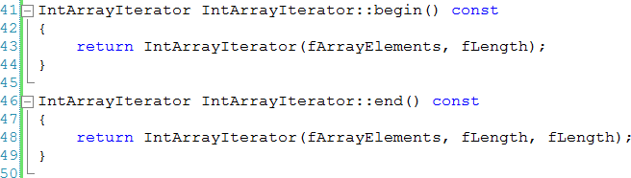
Auxiliary Methods
We use the default value 0 for aStart here.
The methods begin() and end() return fresh iterators set to the first element and past-the-end element, respectively.
The names and implementation of these auxiliary methods follow standard practices.

Slide 43
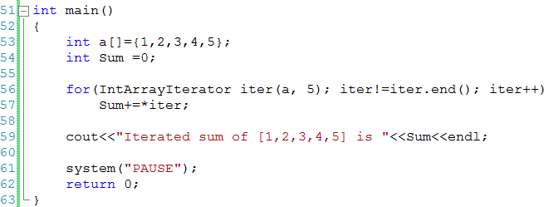
Putting Everything Together

Slide 44
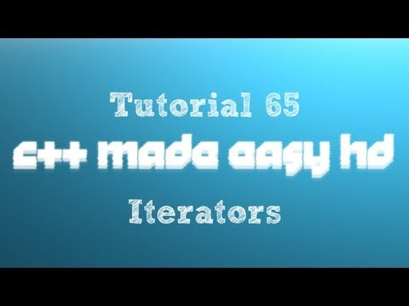
Iterators in C++
URL: https://www.youtube.com/watch?v=5bLNPFlEfqM

Slide 45
What is a Design Pattern?
Christopher Alexander (architect and design theorist) says:
“… [A] pattern describes a problem which occurs over and over again in our environment, and then describes the core of the solution to that problem, in such a way that you can use this solution a million times over, without ever doing it the same way twice.”
Software design patterns are abstractions that help structure system designs.
A design pattern is neither a static solution, nor is it an algorithm.

Slide 46
Why Design Pattern
A pattern is a way to describe and address by
name (mostly a simplistic description of its goal),
a repeatable solution or approach to a common design problem, that is, a common way to solve a generic problem (how generic or complex, depends on how restricted the target goal is).
Patterns can emerge on their own or by design.
This is why design patterns are useful as an abstraction over the implementation and a help at design stage.
With this concept, an easier way to facilitate communication over a design choice as normalization technique is given so that every person can share the design concept.

Slide 47
Design Pattern Elements
Problem/requirement
To use a design pattern, we need to go through a mini analysis design that may be coded to test out the solution. This section states the requirements of the problem we want to solve. This is usually a common problem that will occur in more than one application.
Forces
This section states the technological boundaries, that helps and guides the creation of the solution.
Solution
This section describes how to write the code to solve the above problem. This is the design part of the design pattern. It may contain class diagrams, sequence diagrams, and or whatever is needed to describe how to code the solution.

Slide 48
Design Patterns Are Not About Design
Design patterns are not about designs such as linked lists and hash tables that can be encoded in classes and reused as is.
Design patterns are not complex, domain-specific designs for an entire application or subsystem.
Design patterns are descriptions of communicating objects and classes that are customized to solve a general design problem in a particular context.

Slide 49
Categories of Design Pattern
Depending on the design problem they address, design patterns can be classified in different categories, of which the main categories are:
Creational Patterns
Structural Patterns
Behavioural Patterns

Slide 50
Creational Patterns
Creational patterns abstract the instantiation process. They help to make a system independent of how its objects are created, composed, and represented.
Main forms:
Creational patterns for classes use inheritance to vary the class that is instantiated.
Creational patterns for objects delegate instantiation to another object.

Slide 51
Creational Patterns
Builder: Used to separate the construction of a complex object from its representation so that the same construction process can create different objects representations.
Factory: A utility class that creates an instance of a class from a family of derived classes
Prototype: Used in software development when the type of objects to create is determined by a prototypical instance, which is cloned to produce new objects.
Other Creational Pattern: Singleton

Slide 52
Structural Patterns
Adapter
Bridge
Composite
Decorator
Facade
Flyweight
Proxy
Curiously Recurring Template
Interface-based Programming (IBP)

Slide 53
Behavioural Patterns
Chain of Responsibility
Command
Interpreter
Iterator
Mediator
Memento
Observer
State
Strategy
Template Method
Visitor
Model-View-Controller (MVC)
https://en.wikibooks.org/wiki/C%2B%2B_Programming/Code/Design_Patterns

Slide 54


File Input/Output

Slide 55
Input and output stream
C++ uses a convenient abstraction called streams to perform input and output operations in sequential media such as the screen, the keyboard or a file.
A stream is an entity where a program can either insert or extract characters to/from.
Streams are a source/destination of characters, and that these characters are provided/accepted sequentially (i.e., one after another).

Slide 56
Input and output stream
The standard library defines a handful of stream objects that can be used to access what are considered the standard sources and destinations of characters by the environment where the program runs
Two main operators are stream insertion << and stream extraction >> operators.
The << operator inserts the data that follows it into the stream that precedes it. e.g. the standard output stream cout
The extraction operation on cin uses the type of the variable after the >> operator to determine how it interprets the characters read from the input
stream | description
cin | standard input stream
cout | standard output stream

Slide 57
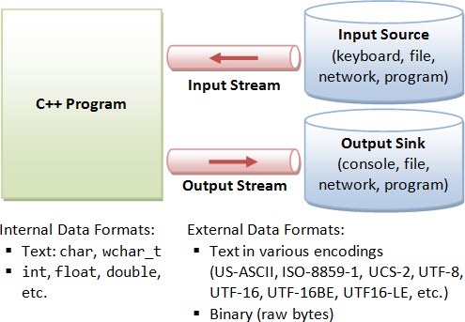
Input and output stream
cin extraction always considers spaces (whitespaces, tabs, new-line...) as terminating the value being extracted, and thus extracting a string means to always extract a single word, not a phrase or an entire sentence.

Slide 58
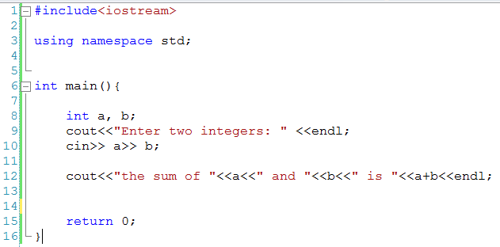
Example

Slide 59
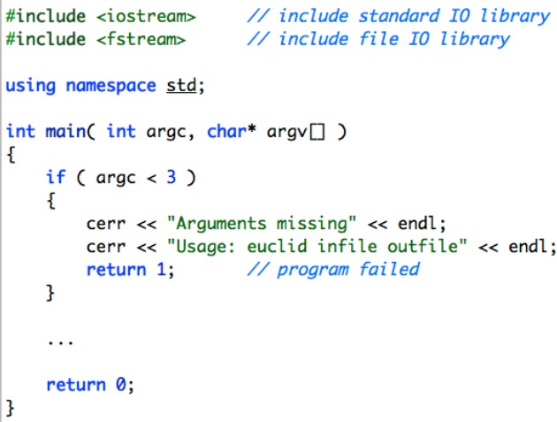
I/O: Working With Files
We can pass the name of the files our program needs to work with through the command line arguments.

Slide 60
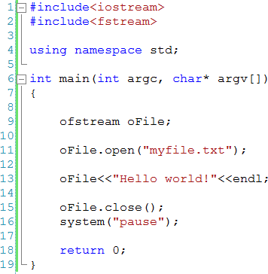
File I/O
You need extra library to handle file input and output rather than standard library.
include <fstream> in your C++ code
Writing to a file …
http://www.cplusplus.com/reference/fstream/

Slide 61
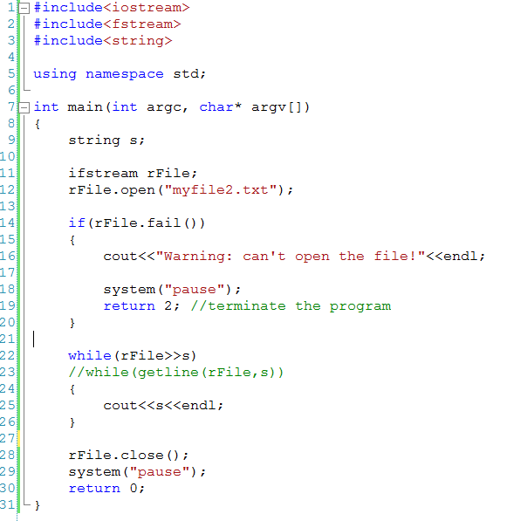
File I/O
Read from a file.

Slide 62
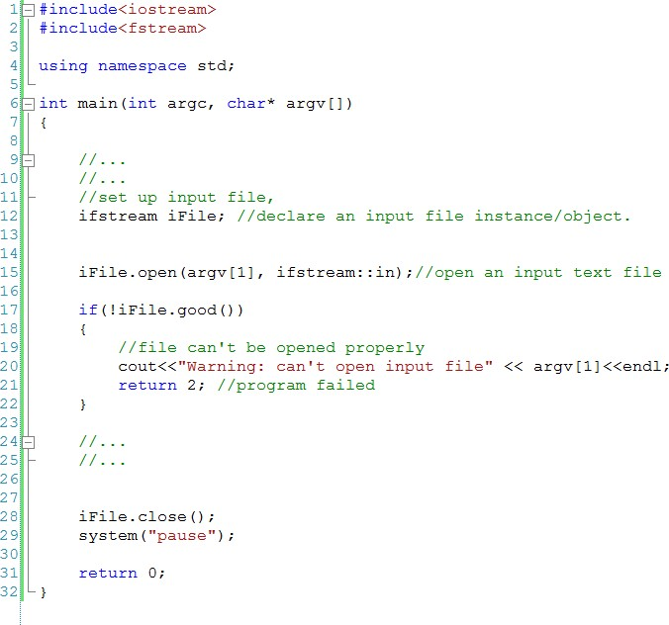
File I/O
Read from a file as an argument.

Slide 63
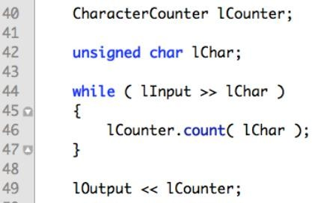
File-based Character Counter
We read input through input file stream lInput and write results to output file stream lOutput.

Slide 64
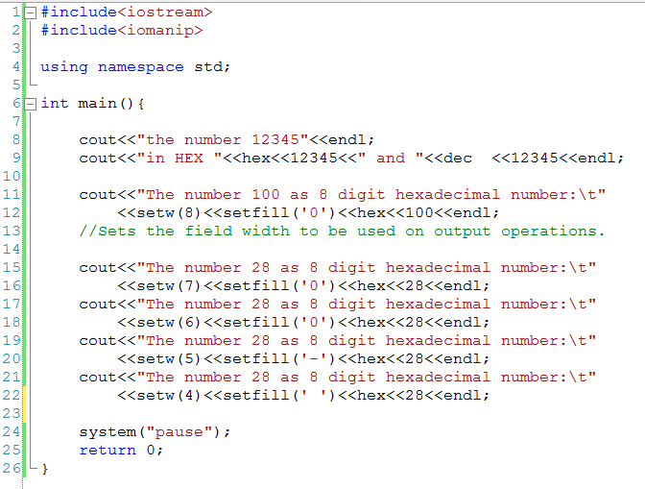
I/O Manipulator Tests

Slide 65
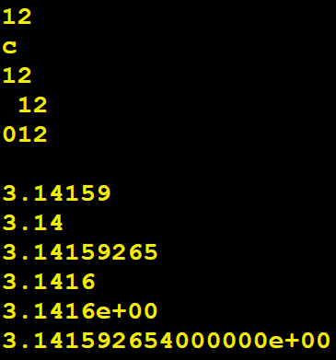
Using I/O manipulators
Formatting an integer value:
int lIValue = 12;
cout cout cout | << << << | lIValue << endl; hex << lIValue << endl; dec << lIValue << endl;
cout | << | setw( 3 ) << lIValue << endl;
cout | << | setw( 3 ) << setfill( '0' ) << lIValue << endl;
Formatting a floating-point value:
double lDValue = 3.141592654; cout << lDValue << endl;
cout << setprecision( 3 ) << lDValue << endl;
cout << setprecision( 9 ) << lDValue << endl;
cout << fixed << setprecision( 4 ) << lDValue << endl; cout << scientific << lDValue << endl;
cout << scientific << setprecision( 15 ) << lDValue << endl;

Slide 66
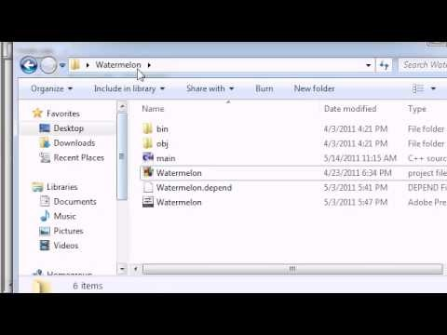
Working with Files in C++
URL: https://www.youtube.com/watch?v=HcONWqVyvlg

Slide 67
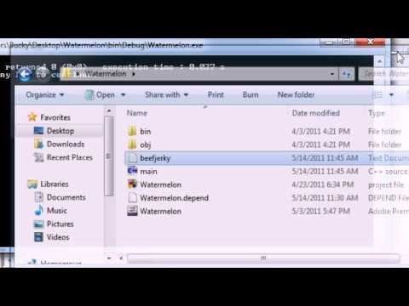
C++ File Handling Tips
URL: https://www.youtube.com/watch?v=qdkabVYgV24

Slide 68
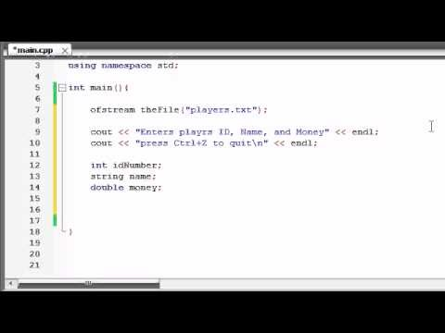
C++ Writing Custom File Structures
URL: https://www.youtube.com/watch?v=iGWhPwh3n-o

Slide 69
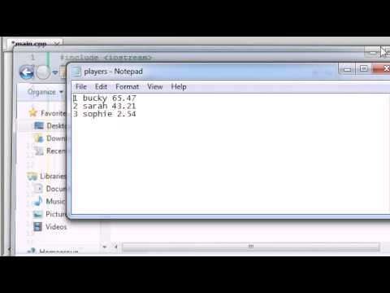
C++ Reading Custom File Structures
URL: https://www.youtube.com/watch?v=EjJY7yA5SWw

Slide 70
End of Basic Concepts

